Slide 1
Biosignal Foundry
Ultra-Low-Power Event-Driven ECG Sensor SoC in GF180MCU
An analog-assisted cardiac feature extraction processor that directly extracts heartbeat timing information from ECG signals and outputs R-R intervals for heart-rate and heart-rate variability (HRV) monitoring.
Surya Varchasvi , Wenxin Zeng, Yutong Wu, Syeda Fatima Fayruj, Leah Berube
Contact email: sdevar02@tufts.edu

Slide 2
Project information
Overview: Traditional ECG systems continuously digitize the entire ECG waveform and perform signal processing digitally. While effective, this approach increases power consumption and data bandwidth requirements.
This project explores an alternative architecture in which critical cardiac features are extracted directly in hardware before digitization. Instead of transmitting the full ECG waveform, the chip detects heartbeats and outputs cardiac timing information, enabling ultra-low-power operation for wearable and implantable biomedical devices.
Key Features
Ultra-low-power ECG acquisition
Analog-assisted QRS feature extraction
Real-time R-peak detection
Event-driven signal processing
Direct R-R interval measurement
Heart rate and HRV estimation
Minimal continuous ADC usage
Designed for wearable and implantable applications

Slide 3
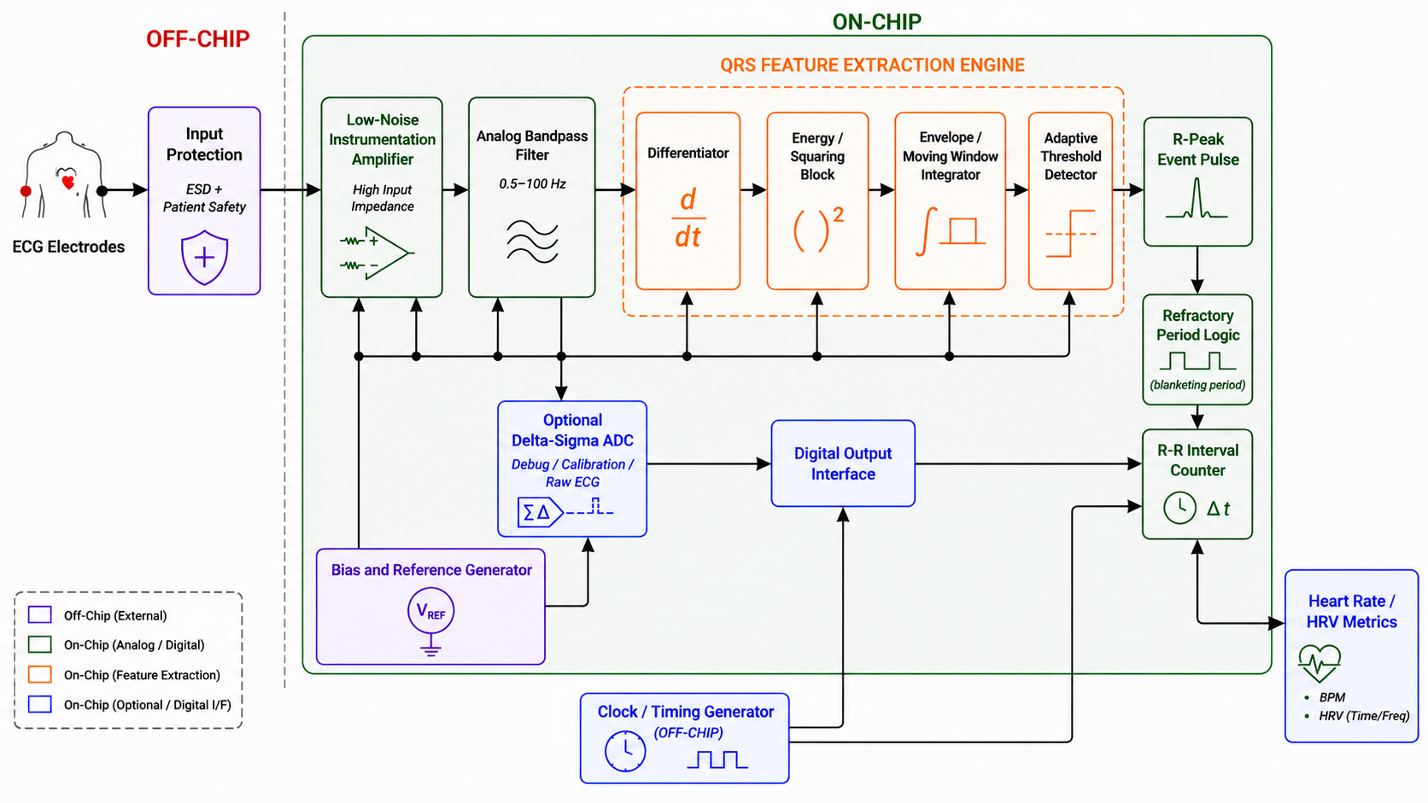
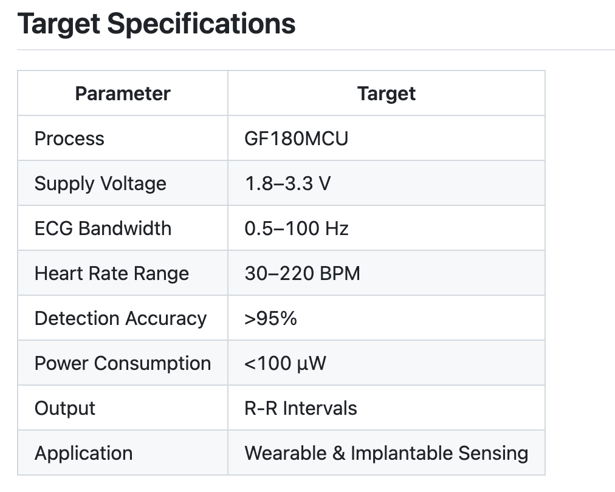



System Architecture

Slide 4
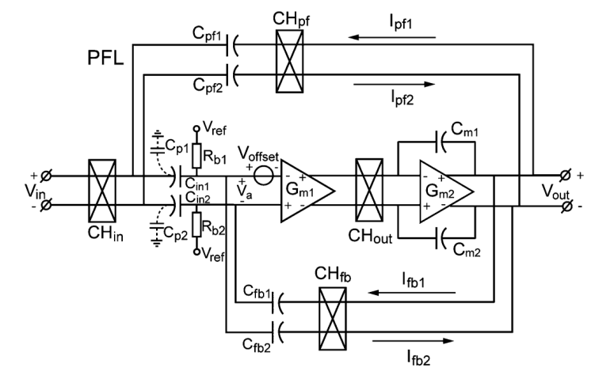
Chopper Stabilized INSTRUMENTATION Amplifier
INA Parameter​ | Target​
Supply​ | 3.3 V​
Gain​ | 40 dB​
Passband​ | 0.05 – 150 Hz​
Input/Output CM​ | 1.65 V​
Output Swing​ | 1 V​
Input CM​ | 0.8 – 2.5 V​
Input Differential​ | 0.1 – 5 mV​
Noise​ | < 200 nV/√Hz​
CMRR​ | > 90 dB​
Input impedance​ | > 100 MΩ​
Input offset tolerance​ | ±300 mV​

Slide 5
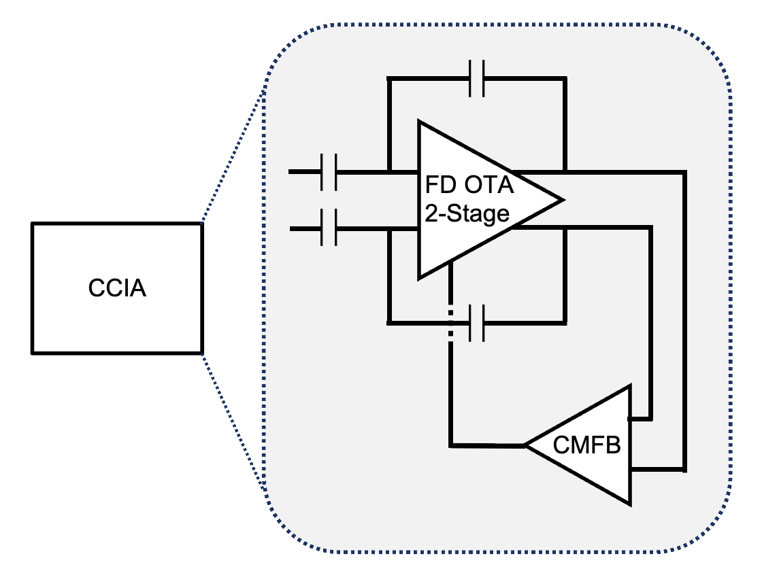
CCIA
OTA Parameter​ | Target​
Supply​ | 3.3 V​
OTA DC Gain​ | 60 - 80 dB​
GBW​ | 1 MHz​
PM​ | > 60°​
Input/Output CM​ | 1.65 V​
Output Swing​ | 1 V​
CMFB Parameter​ | Target​
CMFB DC Gain​ | 40 dB​
GBW​ | 100 KHz​
PM​ | > 60°​

Slide 6
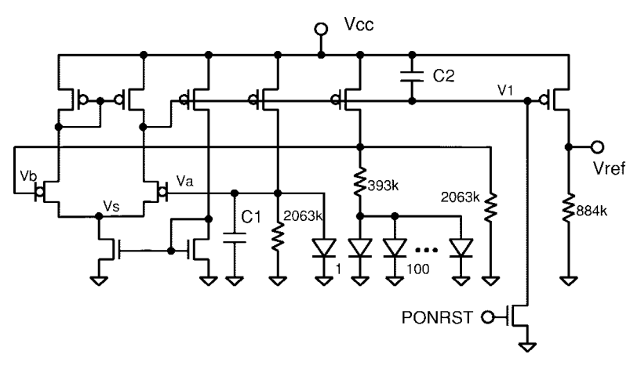
BandGap Reference
A bandgap reference (BGR) circuit is used to generate reference voltages insensitive to temperature
The BGR circuit is self-biased so that no extra pins other than VDD and GND are needed
The BGR will provide specific biasing voltages to the opamps used in the INA design and the filters design
The BGR circuit composes an opamp based on CMOS,diodes based on diode-connected BJTs and resistors​
CMOS devices to be used: nfet_03v3, pfet_03v3​
BJT devices to be used: pnp_05p00x05p00,pnp_05p00x00p42​
Resistor devices to be used: ppolyf_u,ppolyf_u_1k, ppolyf_u_2k, ppolyf_u_3k​

Slide 7
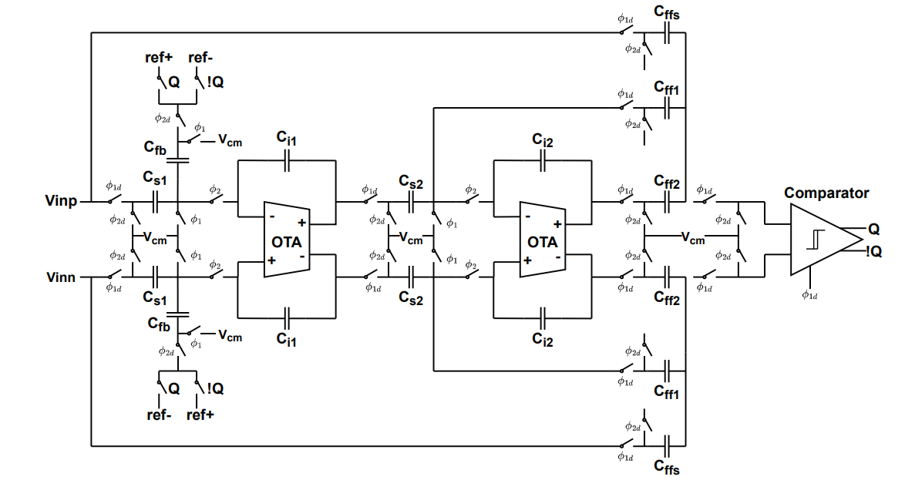
SECOND ORDER DTDSM ADC
Parameter | Target
Topology | 2nd-order DT CIFF, SC
Process / Supply | GF180MCU 180 nm / 3.3 V
Signal bandwidth | 0.5 – 150 Hz
Sampling frequency fs | 76.8 kHz
OSR | 256
Target SNDR | ≥ 78 dB
ENOB | ≥ 13 bit
OTA DC gain | ≥ 60 dB
OTA GBW | ≥ 400 kHz (5 × fs)
Total power | < 30 µW

Slide 8
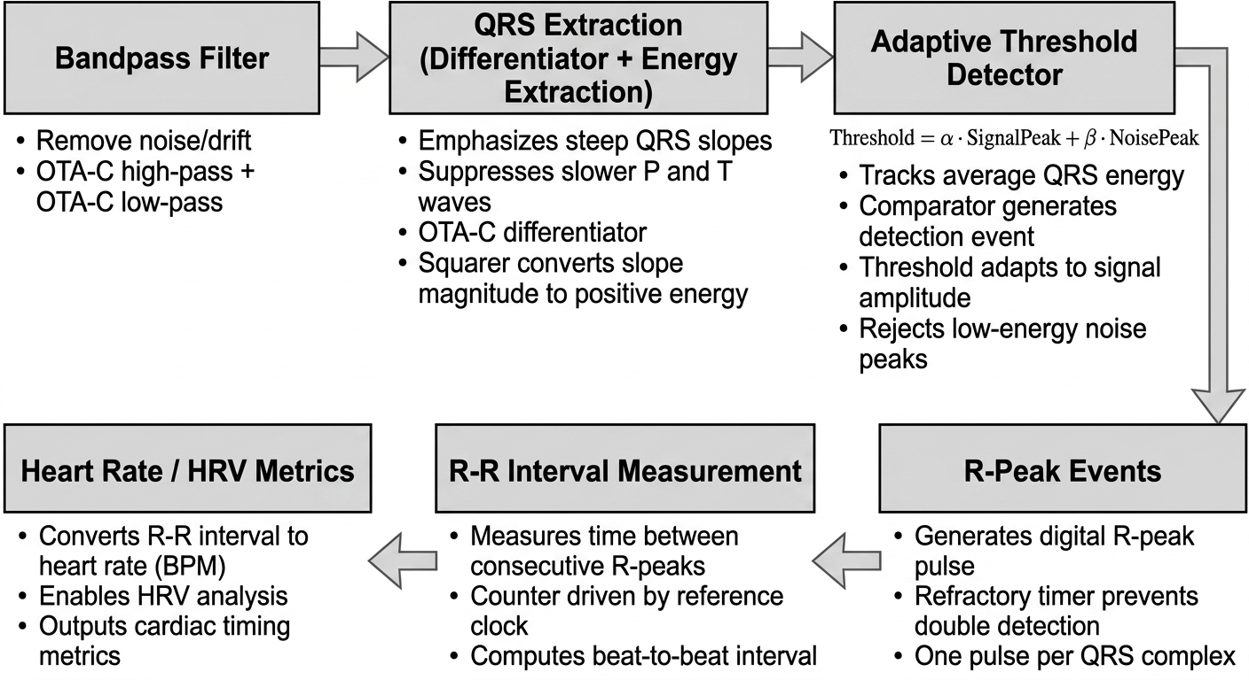
R-R detection using pan Tompkins

Slide 9
Pin Assignment
Pin Name | Direction | Type | Description
INP, INN | Input | Analog | ECG differential input pair
VREF, VBIAS | Input | Analog | Reference voltage and bias trim
VDD_A, GND_A | Supply | Analog | Analog supply and ground (3.3 V)
VDD_D, GND_D | Supply | Digital | Digital supply and ground (1.8 V)
CLK | Input | Digital | Off-chip clock
DET | Output | Digital | R-peak event pulse
RR_OUT | Output | Digital | R-R interval data output
DOUT | Output | Digital | ΔΣ ADC bitstream
MODE | Input | Digital | ADC enable / mode select (Event Trigger / Continuous)

Slide 10
Team background
Team Member | Academic Background / Work Experience
Surya Varchasvi | Postdoctoral Researcher at Tufts University and has 4 tapeout experience with chips ranging from switched-capacitor circuits, current references, PLLs, capacitive sensing front-ends, and level crossing ADC for time mode signal processing.
Wenxin Zeng | Last year PhD in ECE at Tufts University with coursework in Analog and Mixed Signal Design, design experience with CMOS imager, and tape out experience with Level Crossing ADC.
Yutong Wu | 1st year PhD student in ECE at Tufts University with coursework in Analog and Mixed-signal CMOS circuit design and tape-out experience with capacitance sensing for microbials.
Syeda Fatima Fayruj | 2nd Ph.D. student in ECE at Tufts University with coursework in Analog and Digital IC Design, VLSI. Research interests include embedded systems, bioelectronics, and bio-hybrid platforms.
Leah Berube | 2nd Ph.D. student in ECE at Tufts University with coursework in Analog and Digital IC Design. Research interests include wearable bioelectronics and physiological signal processing.

Slide 11
timeline
 | June 15- July 3 | July 6 – July 10 | July 13 – Aug 14 | Aug 17 – Aug 21 | Aug 24 – Aug 28
Circuit Design (Review on July 3)
Simulations (Reviews on July 10 and 17)
Layout (Reviews on Aug 14 and 21)
Final Verification

Slide 12
References
M. N. Imtiaz and N. Khan, "Pan-Tompkins++: A Robust Approach to Detect R-peaks in ECG Signals," 2022 IEEE International Conference on Bioinformatics and Biomedicine (BIBM), Las Vegas, NV, USA, 2022, pp. 2905-2912, doi: 10.1109/BIBM55620.2022.9995552.
C. B. Güngör, P. P. Mercier and H. Töreyin, "A 1.2nW Analog Electrocardiogram Processor Achieving a 99.63% QRS Complex Detection Sensitivity," in IEEE Transactions on Biomedical Circuits and Systems, vol. 15, no. 3, pp. 617-628, June 2021, doi: 10.1109/TBCAS.2021.3092729.
Goud, P. Satyanaraya. ECG SIGNAL PROCESSING FOR COMPUTATION OF BPM USING PAN-TOMPKINS ALGORITHM AND HARDWARE IMPLEMENTATION. Archers & Elevators Publishing House.
Serhani, Mohamed Adel, Hadeel T. El Kassabi, Heba Ismail, and Alramzana Nujum Navaz. 2020. "ECG Monitoring Systems: Review, Architecture, Processes, and Key Challenges" Sensors 20, no. 6: 1796. https://doi.org/10.3390/s20061796

